Slide 1
Construction of minimum variance indices with heteroskedastic time-varying asset covariances
By: Yi (Emily) Wang, Andrew Muth, Crystal Chen

Slide 2
Contents of This Presentation
In this presentation, we will be covering the following topics:
Calculating Price Covariance Matrices
Portfolio Weights
Index Performance
Extension/Future Application
Goals & Motivations
Practical Concerns
Data Cleaning & Preparation
Building Dynamic Conditional Correlation (DCC) Models

Slide 3
Goals & Motivation
Goal: construct a minimum variance index for Agriculture 12 in XDR for all calendar quarter ends starting March 31, 2017 through September 30, 2019.
Agriculture 12 involves the following assets:
Flat Currency: USD, Euro, JPY, Chinese Yuan/Renminbi
Cryptocurrency: Bitcoin, Ethereum, Ripple, Monero
Agri Commodities: Wheat, Soy, Cattle, Lumber
Process:
Individual indices analyzed using univariate ARMA models
Used GARCH models (due to time-varying volatility) to allow index weights adjustment based on changes in asset volatilities and correlations.
Further analysis by building univariate and multivariate models using the dynamic conditional correlation (DCC) method to account for changing covariances and correlations.

Slide 4
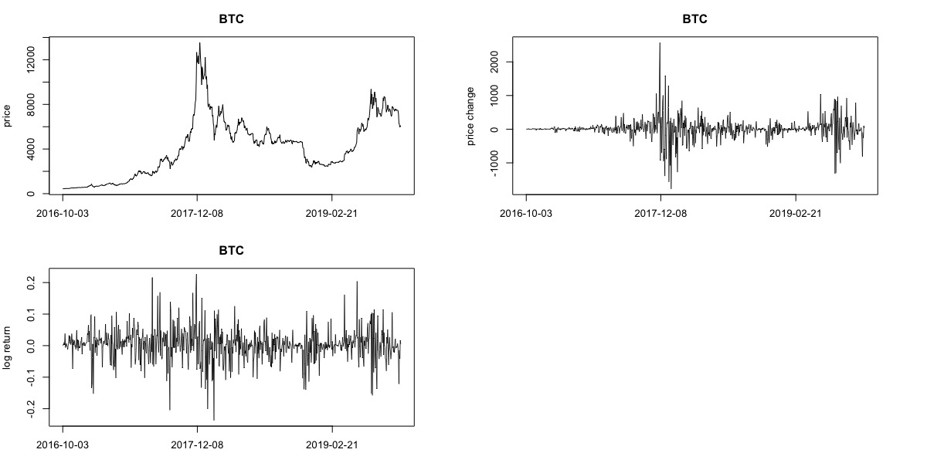
Evidence of Time-Varying volatility
Figure 1: Time series plots of price, change in price and log return of Bitcoin from late 2016 to early 2019

Slide 5

Practical Concerns
Recall:
Unique parameter values per model
(i.e. ARMA(p, q))
Agriculture 12 = 12 assets
12 univariate GARCH models
Solution:
Automation via auto.arima()
Built custom functions to iterate over each asset and fit a model with the lowest information criterion value.
Validation of automation: Manually fitting the GARCH models for selective assets - both automated and manual process produced same modeling results
Conclusion: Automated process did not introduce new errors

Slide 6
Data Cleaning & Preparation
The data cleaning process:
Merge daily close/settle price of all 12 assets into one dataframe;
Set data columns to the appropriate data types;
Remove weekends or US holiday;
Carry forward null values with prices from previous trading day;
Remove missing values at series’ beginning as some data series start from Sept 30th, 2016 while others start from Oct 3rd, 2016;
Convert units of measure to Special Drawing Rights (XDR).
Constructed a daily price difference series and a daily log-return series
Removed data from most recent year (i.e. Q4 of 2018 to Q3 of 2019) removed from training set to act as out-of-sample data to test performance of constructed indices

Slide 7
BUILDING DYNAMIC CONDITIONAL CORRELATION (DCC) MODELS (OUTPUT)
> Box-Ljung test
data: price_data[, 2]
X-squared = 3655.7, df = 5, p-value < 2.2e-16
Conditional Variance Dynamics
-------------------------------
GARCH Model : sGARCH(2,2)
Mean Model : ARFIMA(0,0,2)
Distribution : norm
Optimal Parameters
--------------------------
Estimate Pr(>|t|)
mu 0.720084 0.000000
ma1 1.335115 0.000000
ma2 0.665274 0.000000
omega 0.000001 0.383624
Alpha1 0.000000 0.999985
Alpha2 0.482768 0.000000
beta1 0.472987 0.000064
beta2 0.000000 0.999998

Slide 8
BUILDING DYNAMIC CONDITIONAL CORRELATION (DCC) MODELS (OUTPUT)
Information Criteria
--------------------------
Akaike -8.4587
Bayes -8.4096
Shibata -8.4590
Hannan-Quinn -8.4398
Weighted Ljung-Box Test on Standardized Residuals
------------------------------------
statistic p-value
Lag[1] 133 0
Lag[2*(p+q)+(p+q)-1][5] 791 0
Lag[4*(p+q)+(p+q)-1][9] 1338 0
d.o.f=2
H0 : No serial correlation

Slide 9
BUILDING DYNAMIC CONDITIONAL CORRELATION (DCC) MODELS (OUTPUT)
Weighted Ljung-Box Test on Standardized Squared Residuals
------------------------------------
statistic p-value
Lag[1] 0.06327 0.8014
Lag[2*(p+q)+(p+q)-1][11] 8.09239 0.2088
Lag[4*(p+q)+(p+q)-1][19] 12.54063 0.2244
d.o.f=4

Slide 10
BUILDING DYNAMIC CONDITIONAL CORRELATION (DCC) MODELS (OUTPUT)
Adjusted Pearson Goodness-of-Fit Test:
------------------------------------
group statistic p-value(g-1)
1 20 215.3 2.995e-35
2 30 242.2 1.662e-35
3 40 254.2 2.229e-33
4 50 263.7 3.550e-31

Slide 11
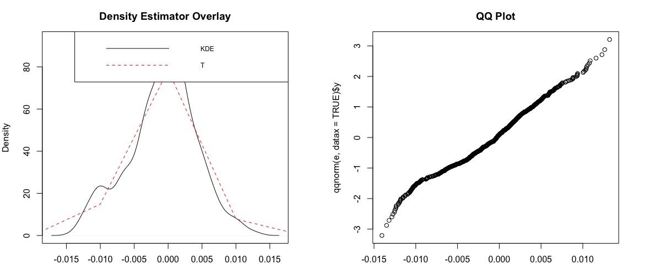
BUILDING DYNAMIC CONDITIONAL CORRELATION (DCC) MODELS (OUTPUT)
Figure 2: (left) KDE of univariate USD GARCH model residuals versus density plot of t-distribution; (right) QQ-plot of univariate USD GARCH model model residuals

Slide 12
BUILDING DYNAMIC CONDITIONAL CORRELATION (DCC) MODELS (OUTPUT)
> get_mLjungBox("../data/agriculture_
price.csv")
K Q(K) d.f. p-value
1 5 33453.5 720 0
* DCC GARCH Fit *
*---------------------------------*
Distribution : mvnorm
Model : DCC(1,1)
No. Parameters : 147
[VAR GARCH DCC UncQ] : [0+79+2+66]
No. Series : 12
No. Obs. : 127
Log-Likelihood : 497.5114

Slide 13
BUILDING DYNAMIC CONDITIONAL CORRELATION (DCC) MODELS (OUTPUT)
Information Criteria
---------------------
Akaike -5.5199
Bayes -2.2278
Shibata -6.6364
Hannan-Quinn -4.1823
> mLjungBox(residuals(model_12), lag=5)
K Q(K) d.f. p-value
1 5 1726.64 720 0

Slide 14
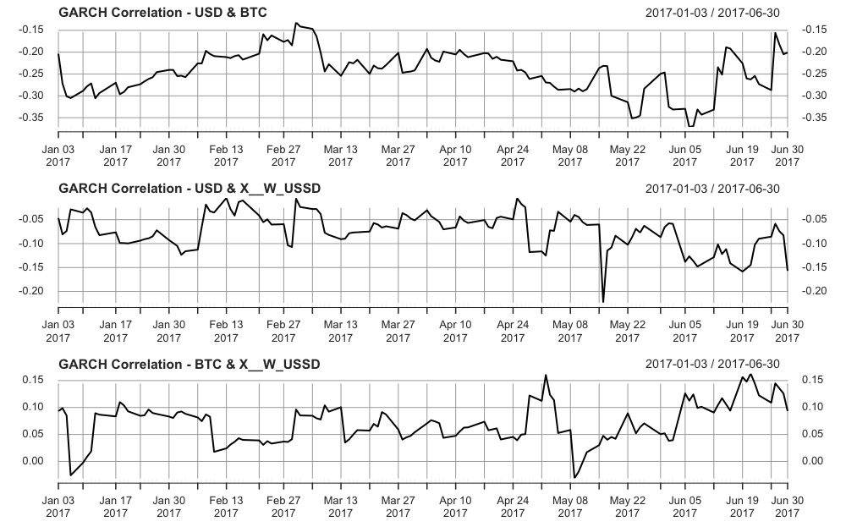
Calculating Price Covariance Matrices
Figure 3: (top) daily correlation estimates between USD and Bitcoin between Jan 3, 2017 to June 30, 2017; (middle) daily correlation estimates between USD and Wheat between Jan 3, 2017 to June 30, 2017; (bottom) daily correlation estimates between Bitcoin and Wheat between Jan 3, 2017 to June 30, 2017

Slide 15
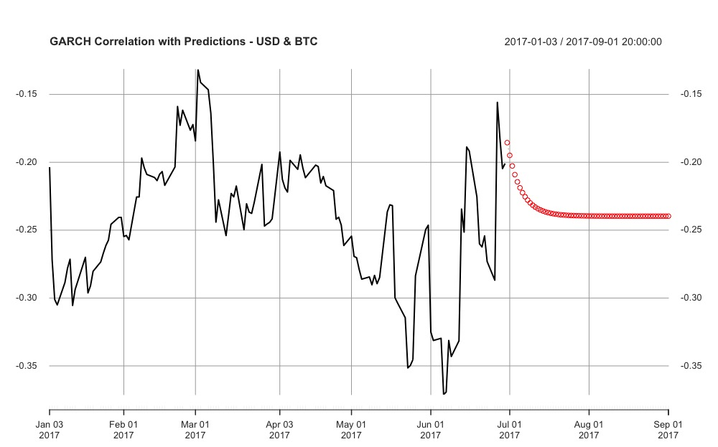
Calculating Price Covariance Matrices
Figure 4: daily correlation estimates between USD and Bitcoin between Jan 3, 2017 to June 30, 2017 with forecasts to Sept 30, 2017

Slide 16
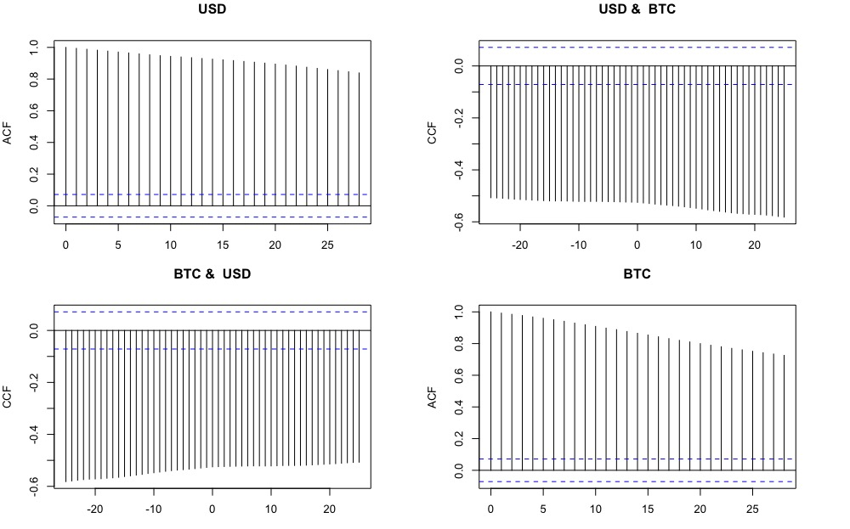
Calculating Price Covariance Matrices
Figure 5: (top left) ACF of USD; (top right) CCF of USD vs. Bitcoin; (bottom left) CCF of Bitcoin vs. USD; (bottom right) ACF of Bitcoin

Slide 17
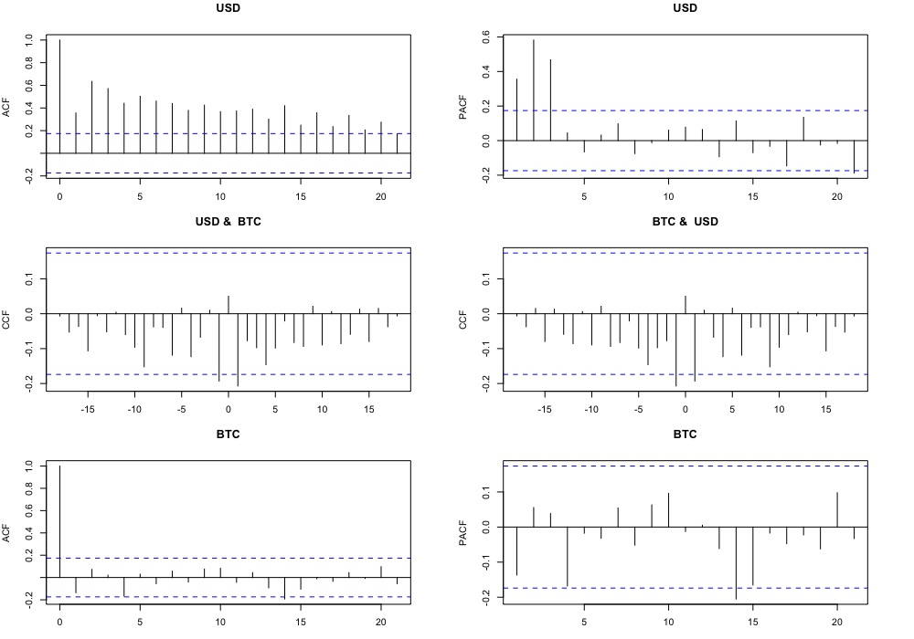
Calculating Price Covariance Matrices
Figure 6: (top left) ACF of USD; (top right) PACF of USD; (middle left) CCF of USD vs. Bitcoin; (middle right) CCF of Bitcoin vs. USD; (bottom left) ACF of Bitcoin; (bottom right) PACF of Bitcoin

Slide 18
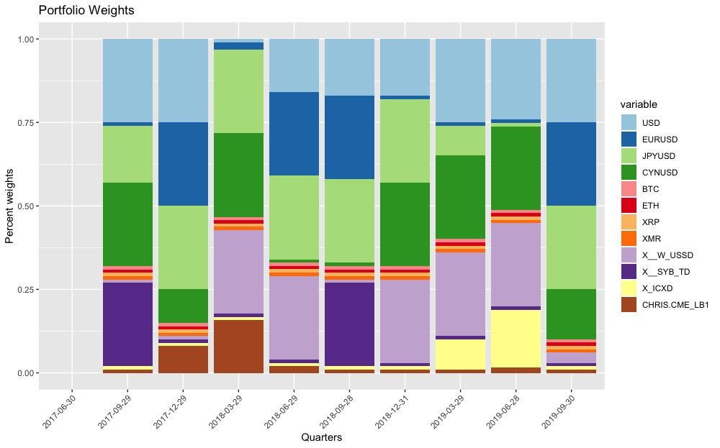
Portfolio Weights
Figure 7: Portfolio reweights for raw prices over June 30, 2017 to Sept 30, 2019

Slide 19
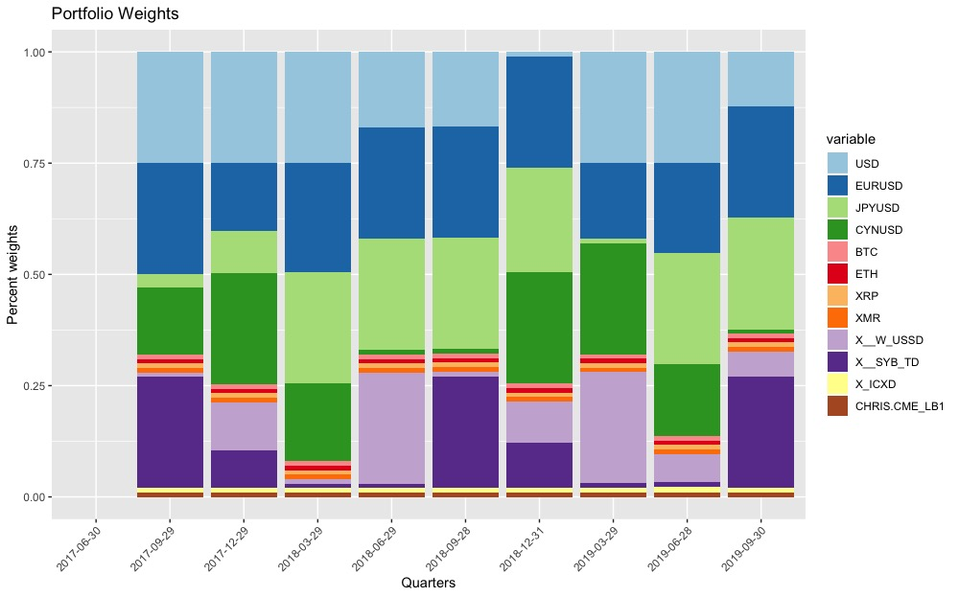
Portfolio Weights
Figure 8: Portfolio reweights for price difference over June 30, 2017 to Sept 30, 2019

Slide 20
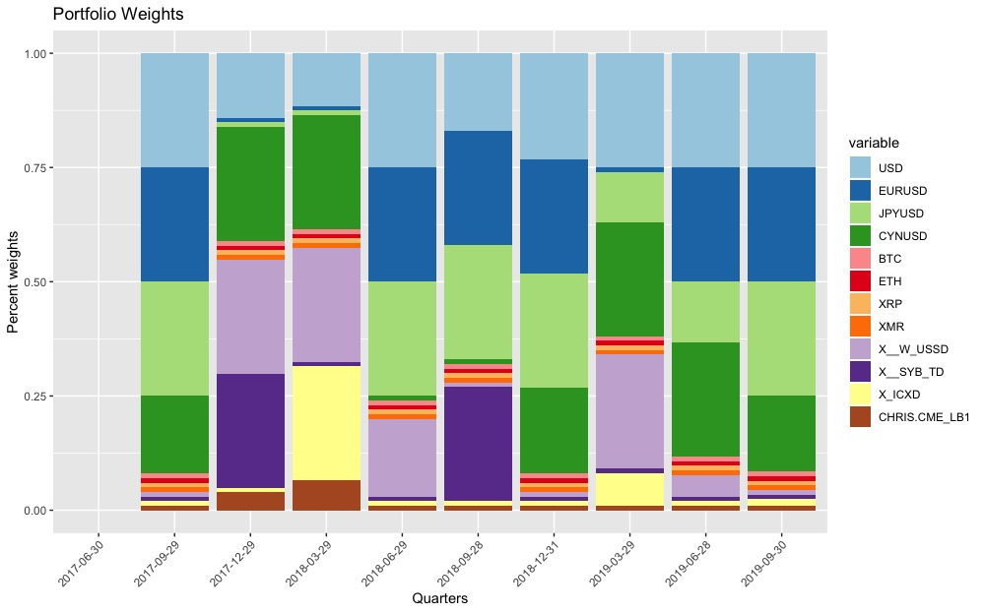
Portfolio Weights
Figure 9: Portfolio reweights for log-returns over June 30, 2017 to Sept 30, 2019

Slide 21
INDEX PERFORMANCE
Figure 10: Index price change of raw prices, price difference, log-returns benchmarked against SMP 500 from June 30, 2017 to Sept 30, 2019. (Source: Yohoo Finance SMP 500 Index Adj.close)

Slide 22
INDEX PERFORMANCE
Figure 11: Index price change of raw prices, price difference, log-returns benchmarked against SMP 500 from Oct 1, 2018 to Sept 30, 2019. (Source: Yahoo Finance S&P 500 Index Adj.close

Slide 23
Extension/Future application
Immediate improvements:
Using more data than past two quarter
Allows GARCH residuals to be modeled by a more appropriate distribution (e.g. symmetric/skewed t-distribution
Allows for testing of more complex GARCH models for better representation of return series.
Specifying a minimum portfolio return
Note: the quadratic programming problem of choosing the minimum volatility weights should still be well defined
Allows for construction of smart beta indices designed to outperform a particular market cap weighted index while still being composed of the same assets

Slide 24
Thank you for listening

